Slide 1
Agile Design of Efficient Processing Technologies
Krste Asanović, Bora Nikolić, Elad Alon, Jonathan Bachrach, Jim Demmel, Jonathan Ragan-Kelley, Koushik Sen, Sanjit Seshia, Sophia Shao, + cast of thousands
ADEPT End of Project Celebration, Virtual
December 9, 2021

Slide 2
Oops, we did it again!
Made it to the end of the project! (plus starting the next!)

Slide 3
ADEPT Timeline
DARPA CRAFT start
Intel iSTC start
ADEPT (soft) launch
RISE launch
ASPIRE End of Project Party!
Start AMP+ASPIRE Successor Meetings
ADEPT 1st Retreat
ADEPT 7th Retreat
2015
2016
2017
2018
2019
2020
2021
2022
ADEPT End of Project Party!
Started ADEPT Successor Meetings
You are here

Slide 4
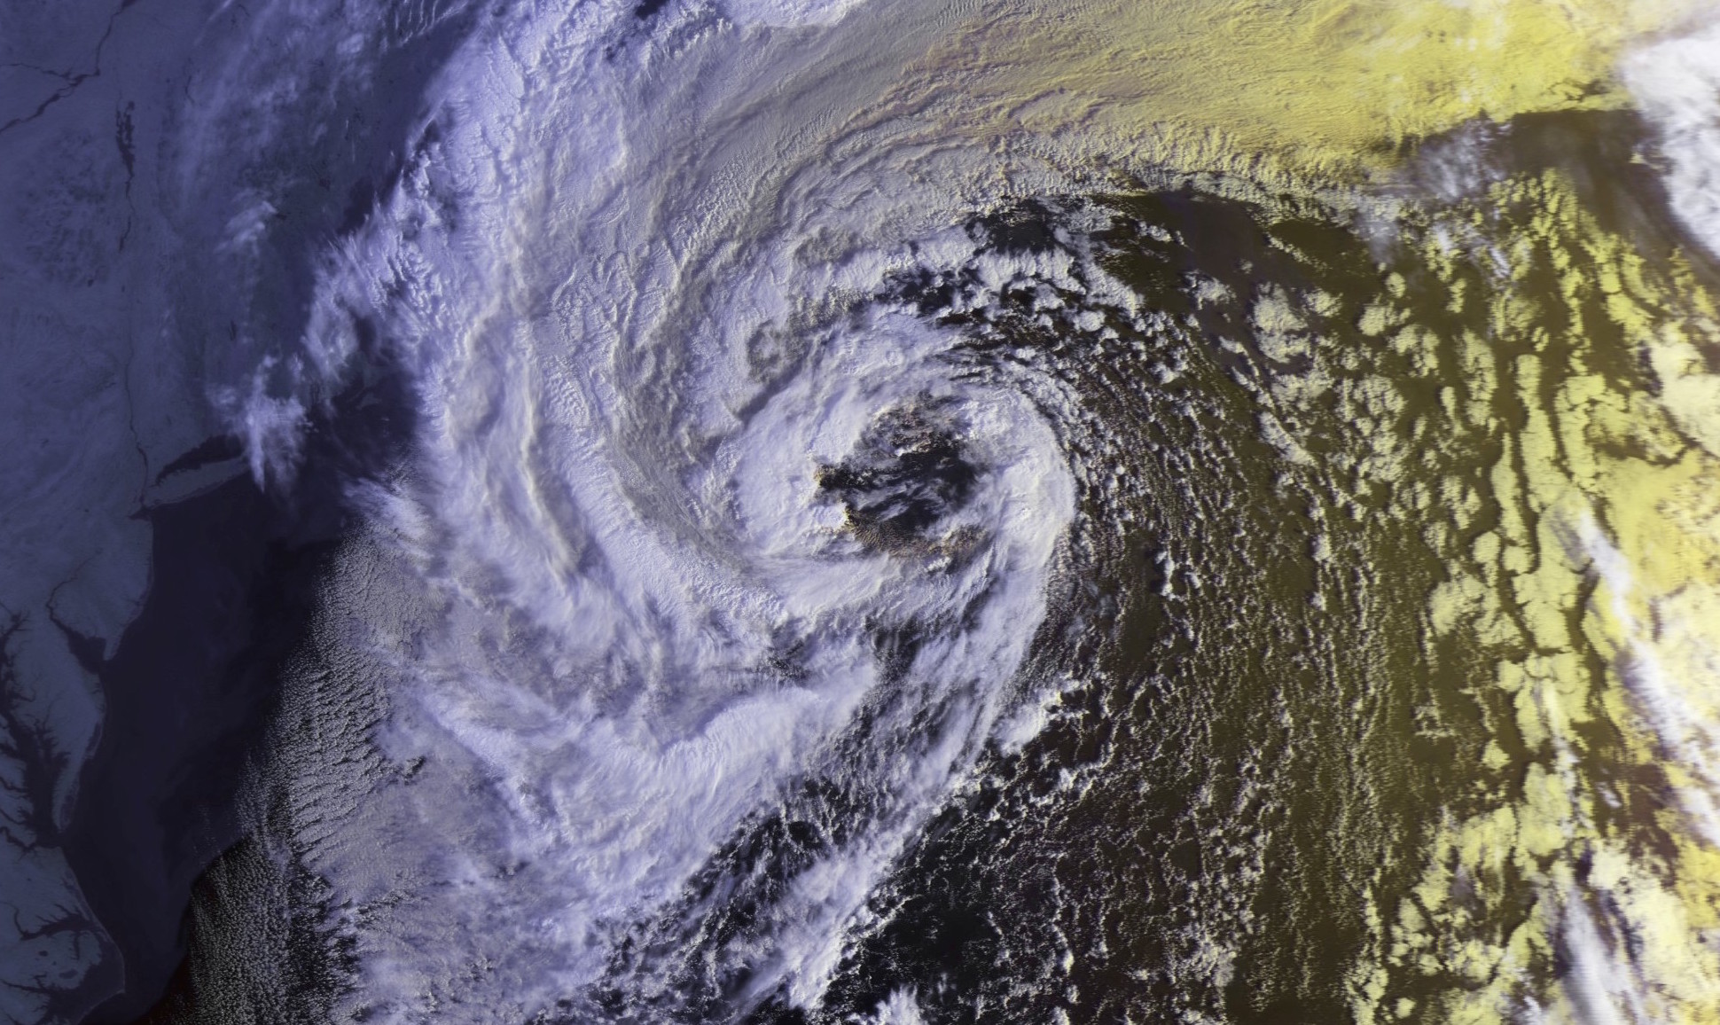
Semiconductor Industry Perfect Storm
“Cold air”
Custom chip design too costly, slow, risky
“Hot air”
New applications need capabilities from custom chips:
AI/Machine Learning/Inference,
IoT, Autonomous Vehicles, …

Slide 5
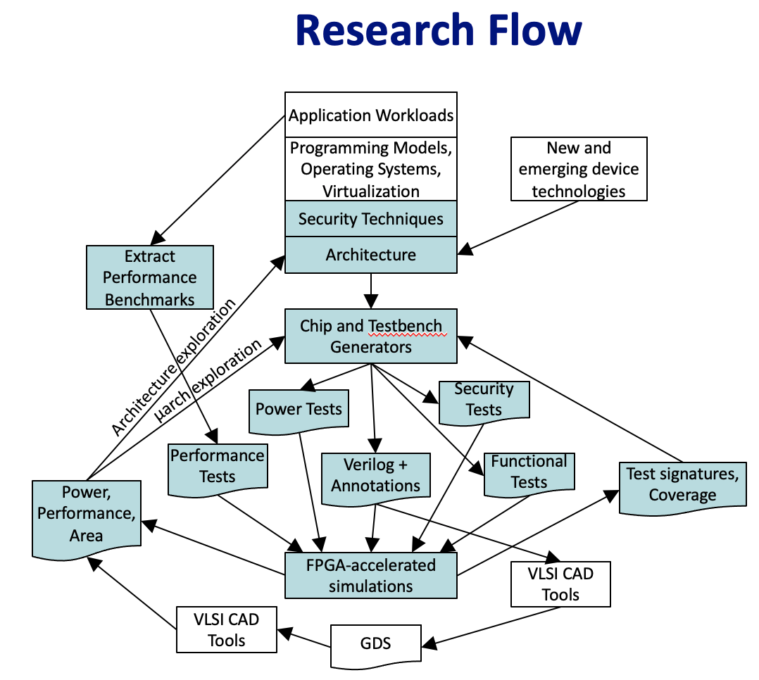
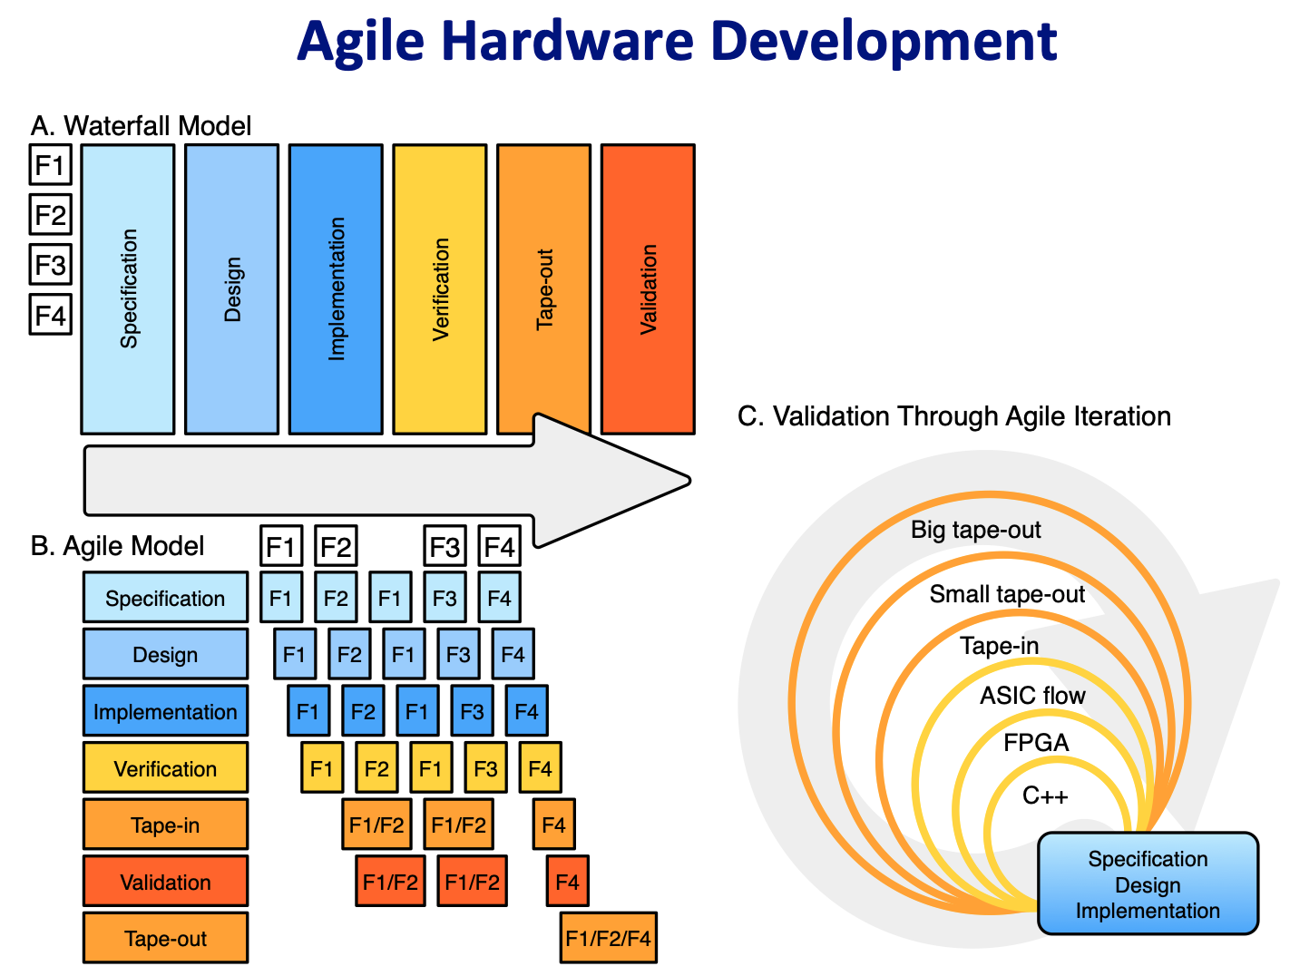
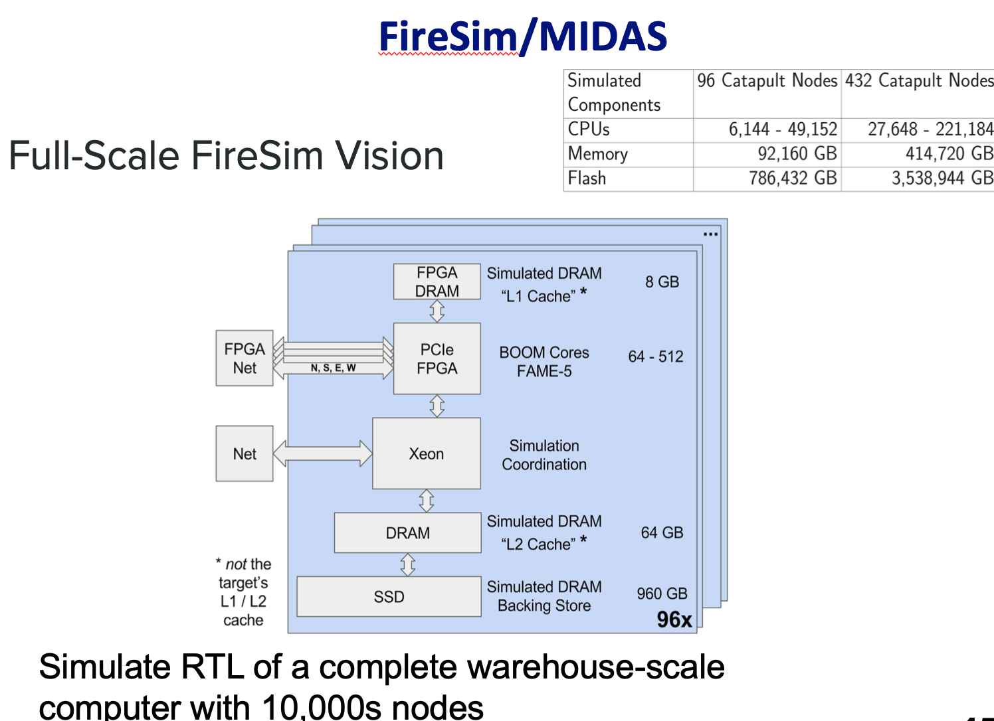
What did we think we’d do?
[ Slides from Intel Center Kickoff October 2016, plus Berkeley Visit Day March 2017 ]

Slide 6
What did we actually do?
Talks today show highlights of what we produced
Impossible to include everything, so check publications!
Plus a few testimonials from our sponsors in industry
Thank you sponsors!
Intel
Apple, Futurewei, Google, Qualcomm, Seagate, Western Digital
But our primary output is an amazing set of graduated/graduating students, some of who came back to give their talks!

Slide 7
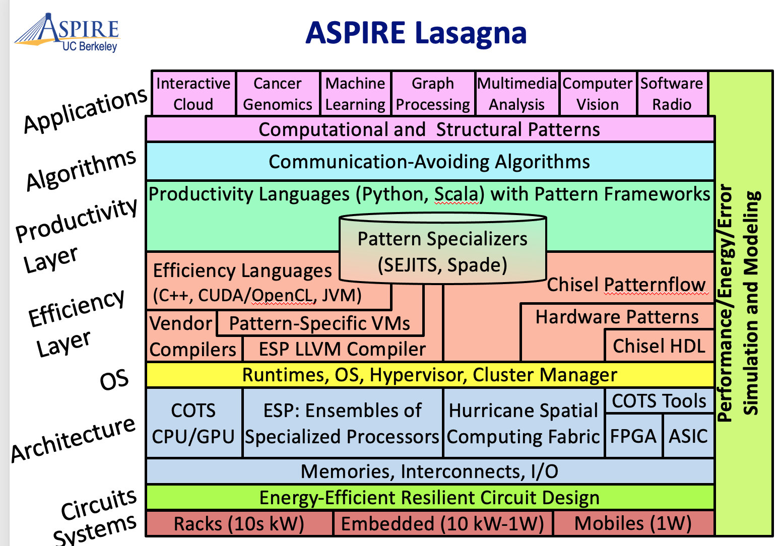
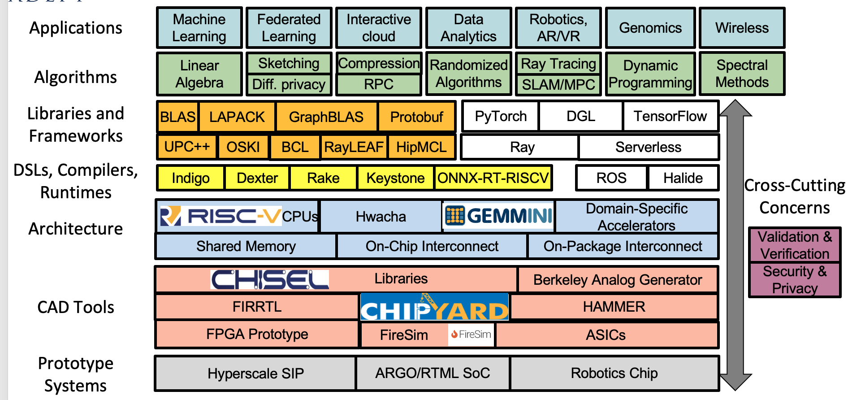
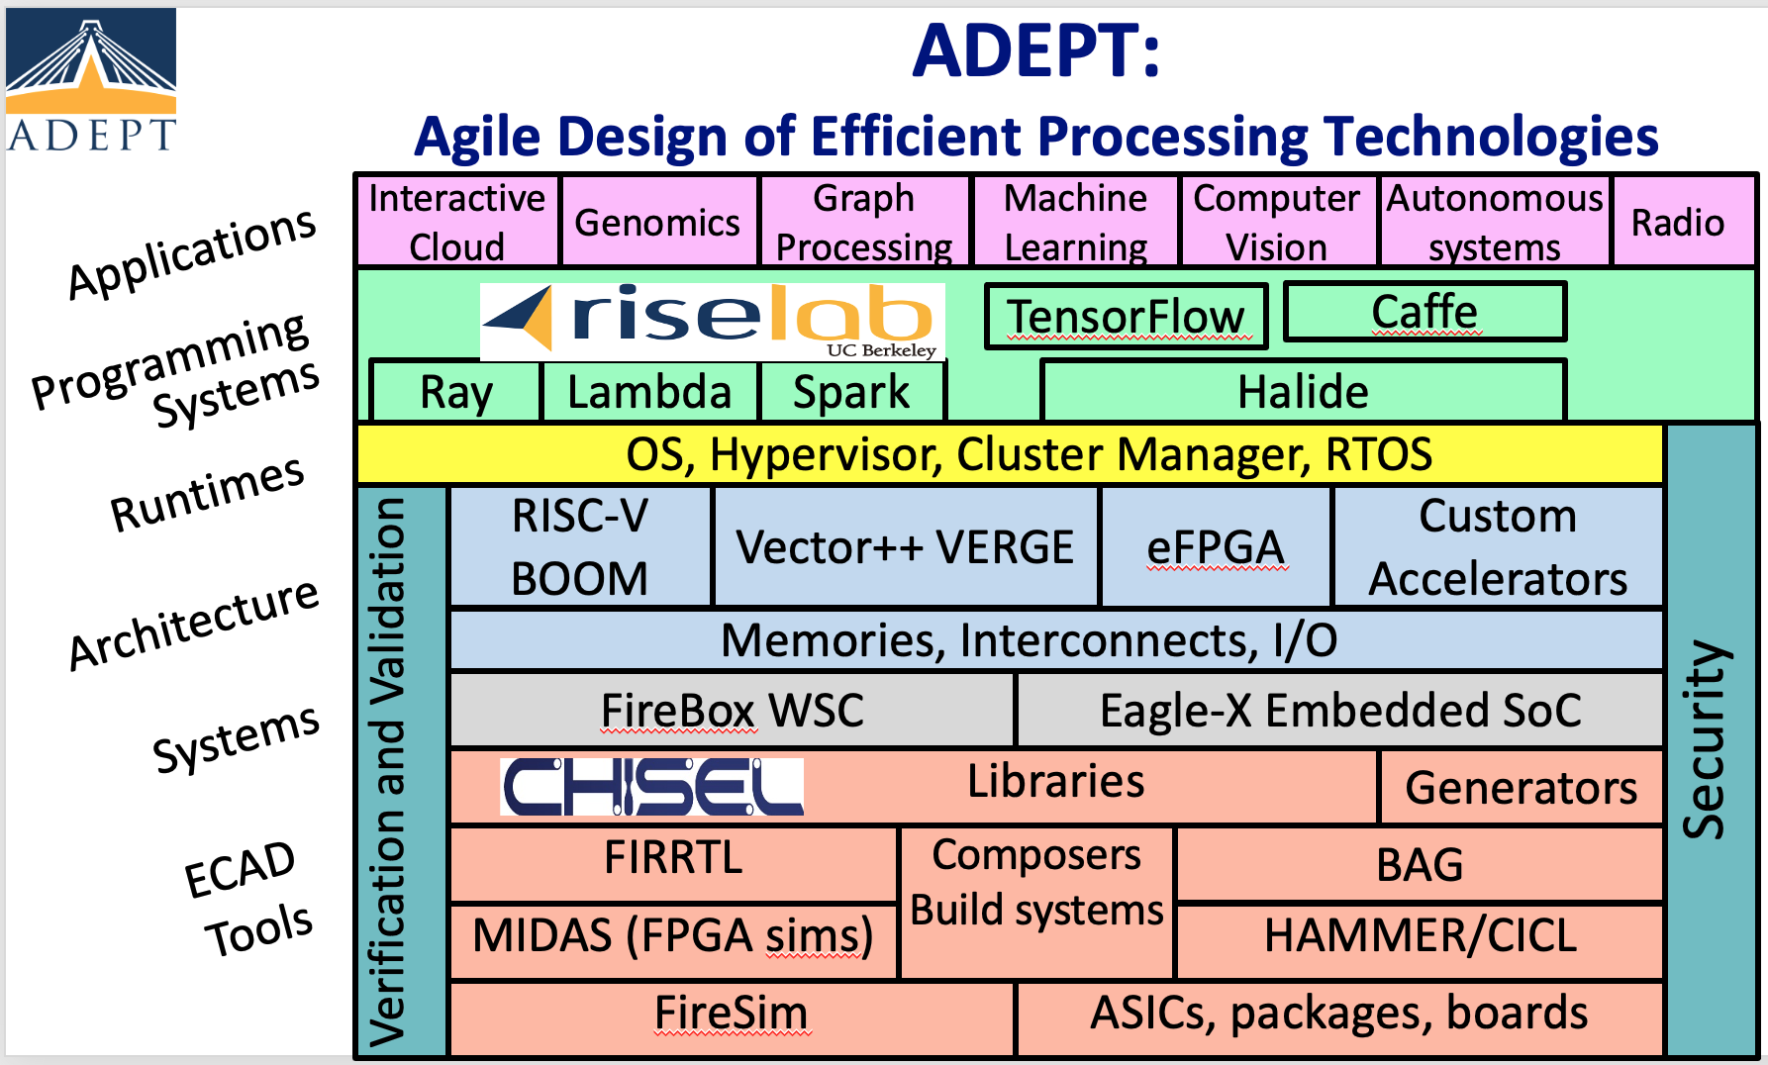
Berkeley “Lasagna Lab” Generations
SLICE Lab

Slide 8
SLICE:
SpeciaLIzed Computing Ecosystems
Bora Nikolić, Krste Asanović, Aydin Buluç, Alvin Cheung, Jim Demmel, Tsu-Jae King Liu, Jelani Nelson, Sophia Shao, Kathy Yelick

Slide 9
Golden Age of Computer Architecture
100,000
End of Moore’s Law ⇒ 2x/20 years (3%/year)
Amdahl’s Law ⇒ 2x/6 years (12%/year)
End of Dennard Scaling ⇒ Multicore
2x/3.5 years (23%/year)
10,000
Performance vs. VAX11/780
SLICE Lab: Pervasive Domain
Specialization
1,000
RISC 2X/1.5 years
(52%/year)
100
CISC 2X/2.5 years
(22%/year)
10
1
1975
1985
1995
2005
2015
2025
2035
ParLab
ASPIRE
ADEPT
SLICE
Performance: SPECintCPU
Hennessy, Patterson, “A New Golden Age for Computer Architecture, CACM’19

Slide 10
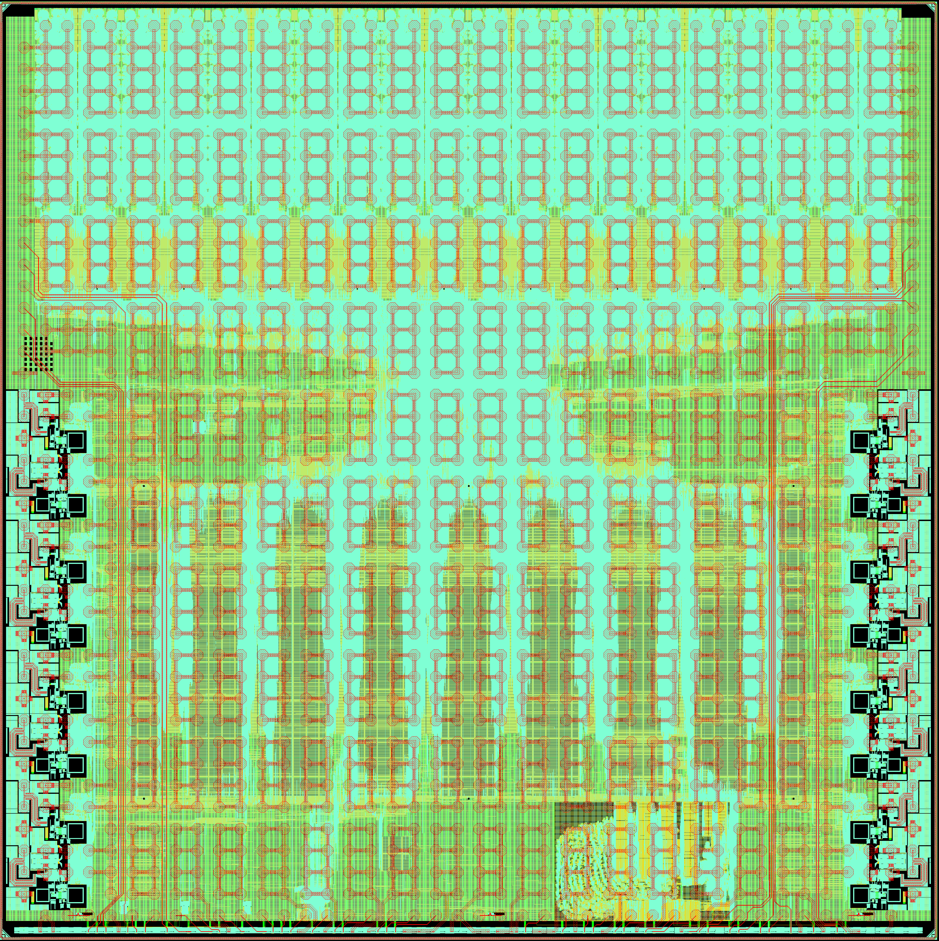
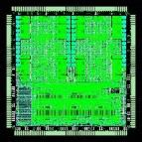
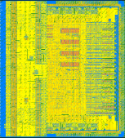
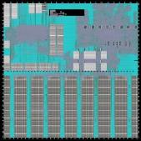
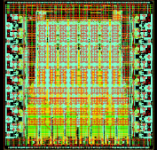
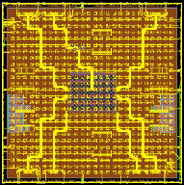
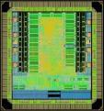
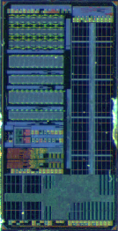
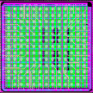
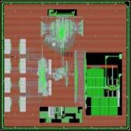
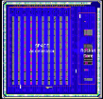
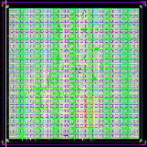
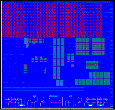
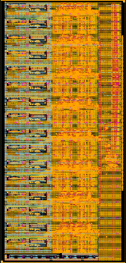
We Have Built a Lot of Chips!
Verilog
Chisel
Chisel2
Chisel3+BAG2
BAG
EAGLEX
Raven-2
EAGLE
Hurricane-1
Hurricane-2
CraftP1
Raven-1
Raven-3
Raven-4
FADER
May
Apr
Aug
Feb
Jul
Sep
Mar
Nov
Mar
Apr
Jul
Mar
May
Jun
Mar
2011
2012
2013
2014
2015
2016
2017
2018
2019
2020
EOS18
EOS20
CRAFT-0
AI
EOS14
EOS16
SWERVE
GPS
FFT2
EOS22
EOS24
Raven, Hurricane: ST 28nm FDSOI, SWERVE: TSMC 28nm EOS: IBM 45nm SOI, CRAFT: 16nm TSMC, Intel 22nm

Slide 11
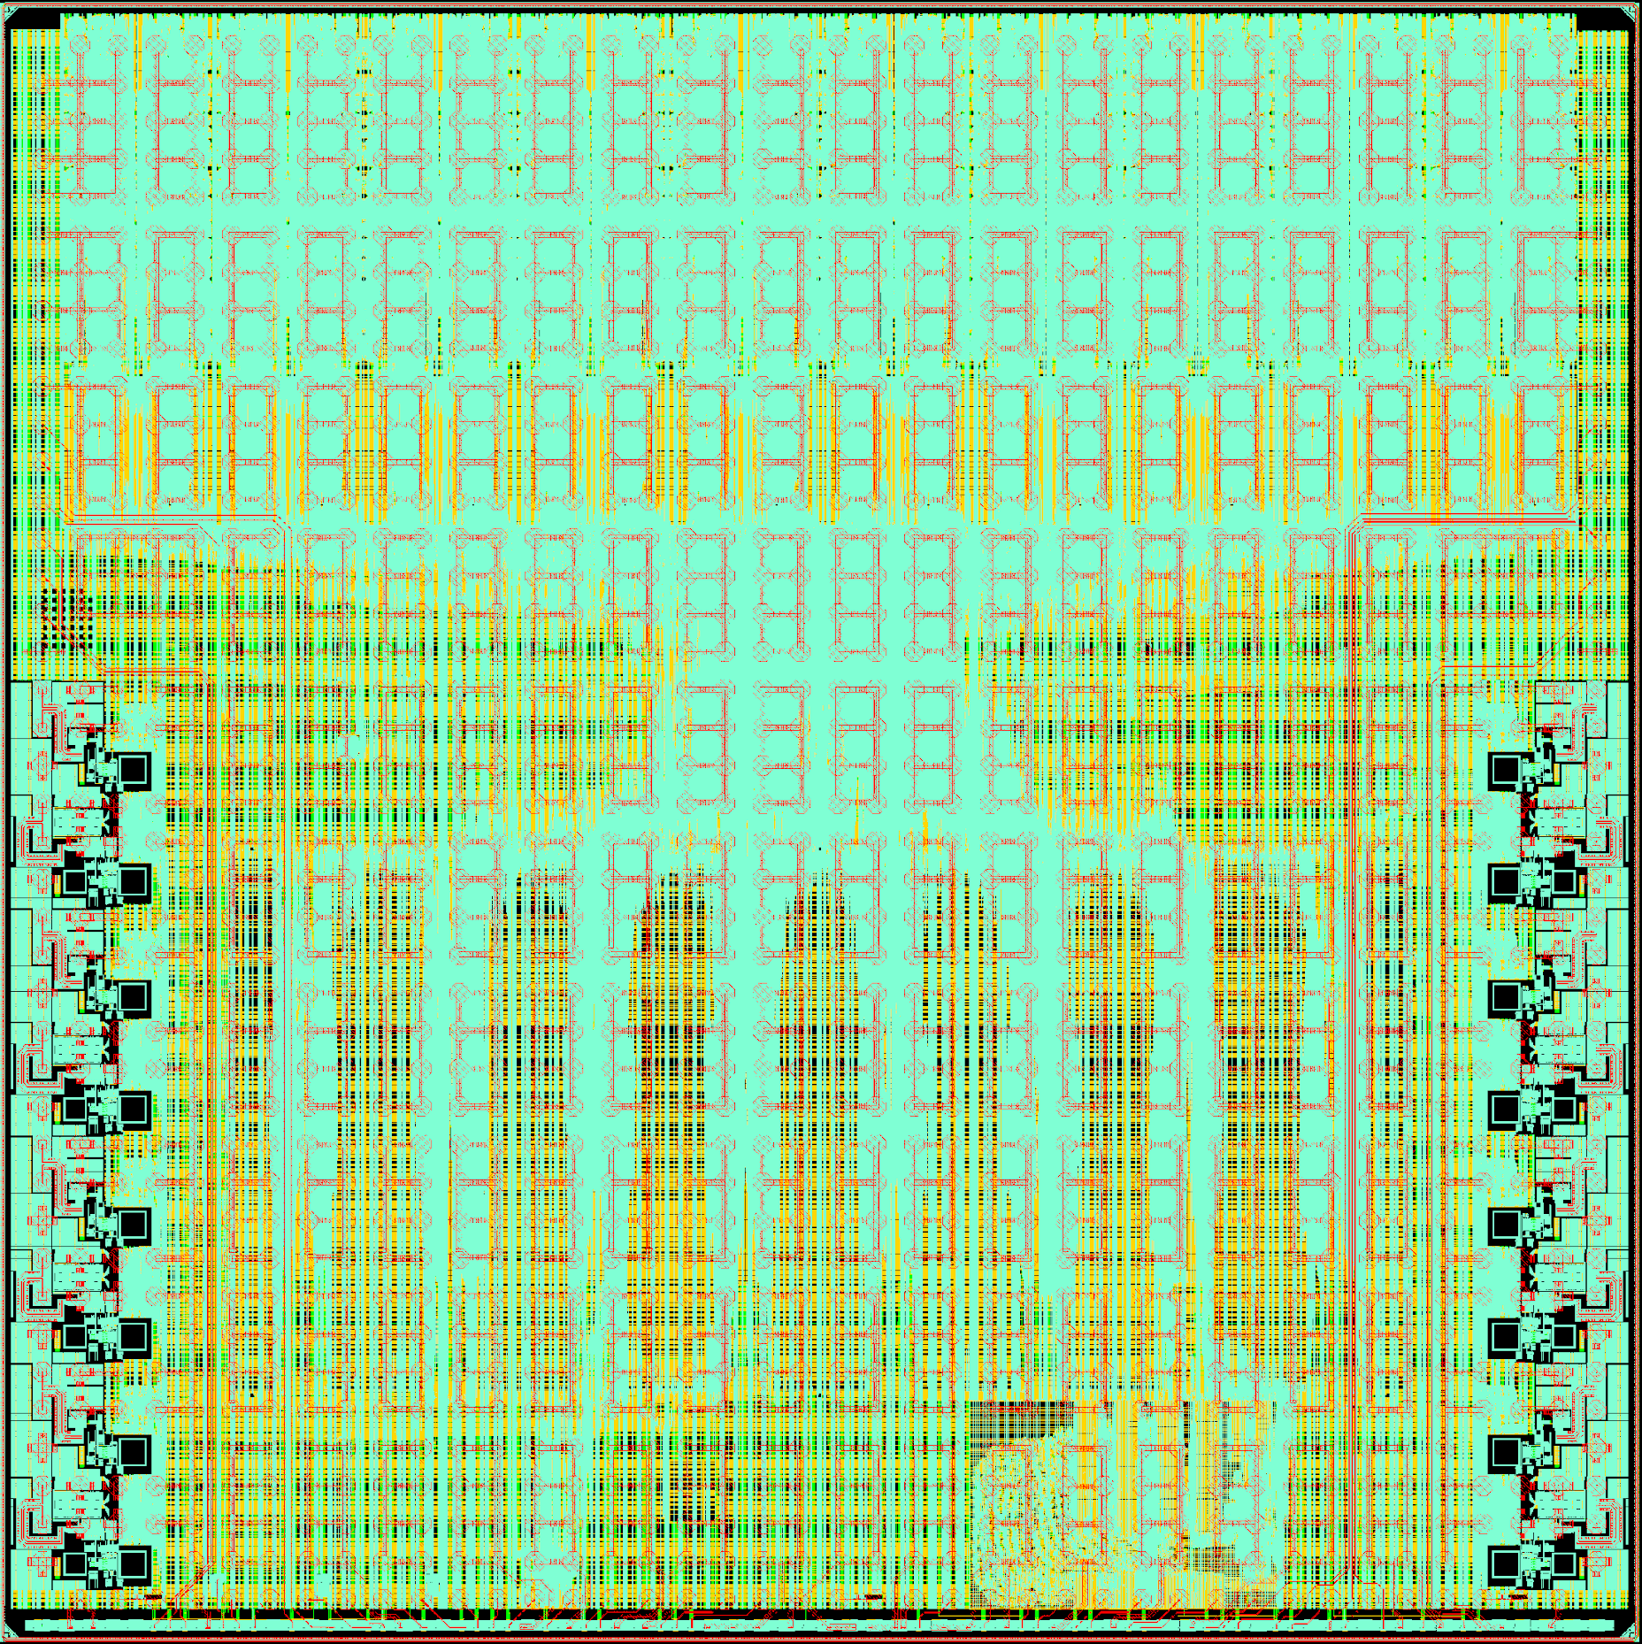
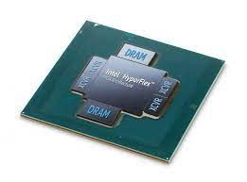
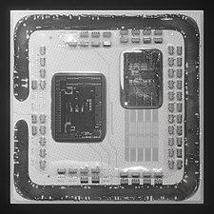
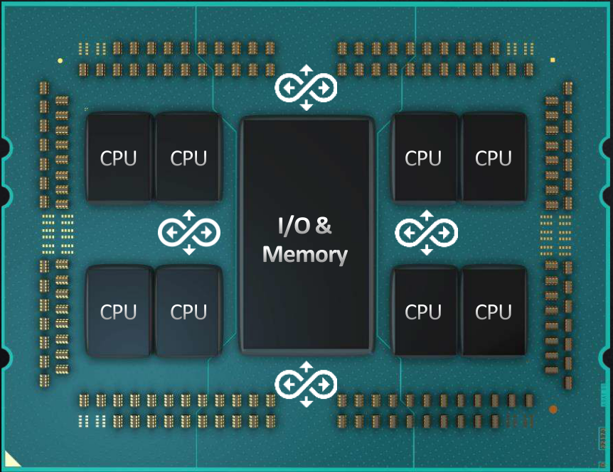
Very Large Scale Disintegration
Research: Bigger chips test our design methodologies
chiplet
chiplet
chiplet
chiplet
Industry: Bigger chips make up for Moore’s law sunset
L. Su, HotChips’19 Keynote

Slide 12
Chiplets reduce NRE for Specialized Systems
Chiplets allow peripherals, general compute, & accelerators to each evolve at appropriate rate:
Slow change in chiplet-to-chiplet and off-chip physical interfaces
Moderate rate change in general-purpose compute
Fast evolution in custom accelerators/algorithms
SLICE to develop new chiplet-based architectures, interface standards, design flows, software
Chiplet discovery, protocol negotiations?
Establish draft open standards
Innovate in domain-specific accelerators, driven by important applications and algorithms
Develop new industry around chiplet-based systems
chiplet
Compute complex
chiplet
chiplet
chiplet
Physical interfaces: AIB, CoWoS

Slide 13
Innovative Ideas across the Stack
Applications: Federated Learning, Vision, Robotics++
Algorithms: Randomized BLAS, Sketching, SLAM
Compilers: Specialized DSLs integrated with regular compile process
Runtime: OS/runtime running across all cores/chiplets
Architecture: GPP (BOOM) + Generated Programmable Accelerators (Saturn/Gemmini) + Fixed function accelerators + NoC (Constellation) + chiplet interfaces
Design: Large-scale agile hardware design and verification/validation
Circuits: Differentiated macros for efficiency, interconnects, interfaces
Fabrication: Pervasive chiplets, New technologies

Slide 14
SLICE Lab Objective
Develop full-stack heterogeneous compute systems that optimally map applications to domain-specific SoCs and SiPs, using advanced fabrication and packaging technologies
We will leverage and extend agile software and hardware prototyping for the design, verification and validation of complete systems

Slide 15
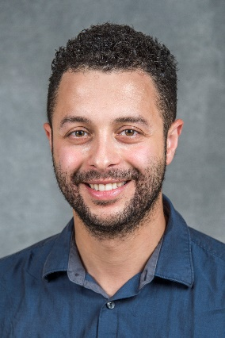
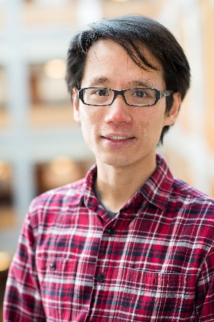
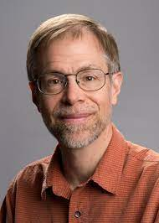
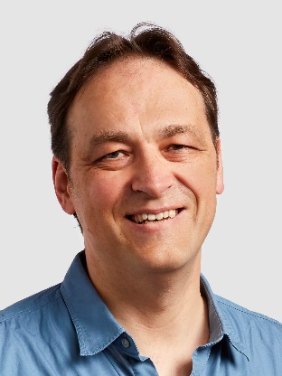
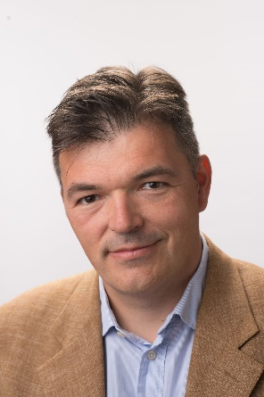
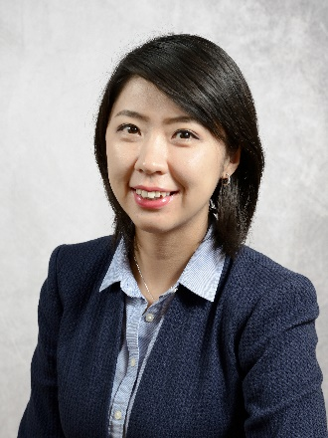
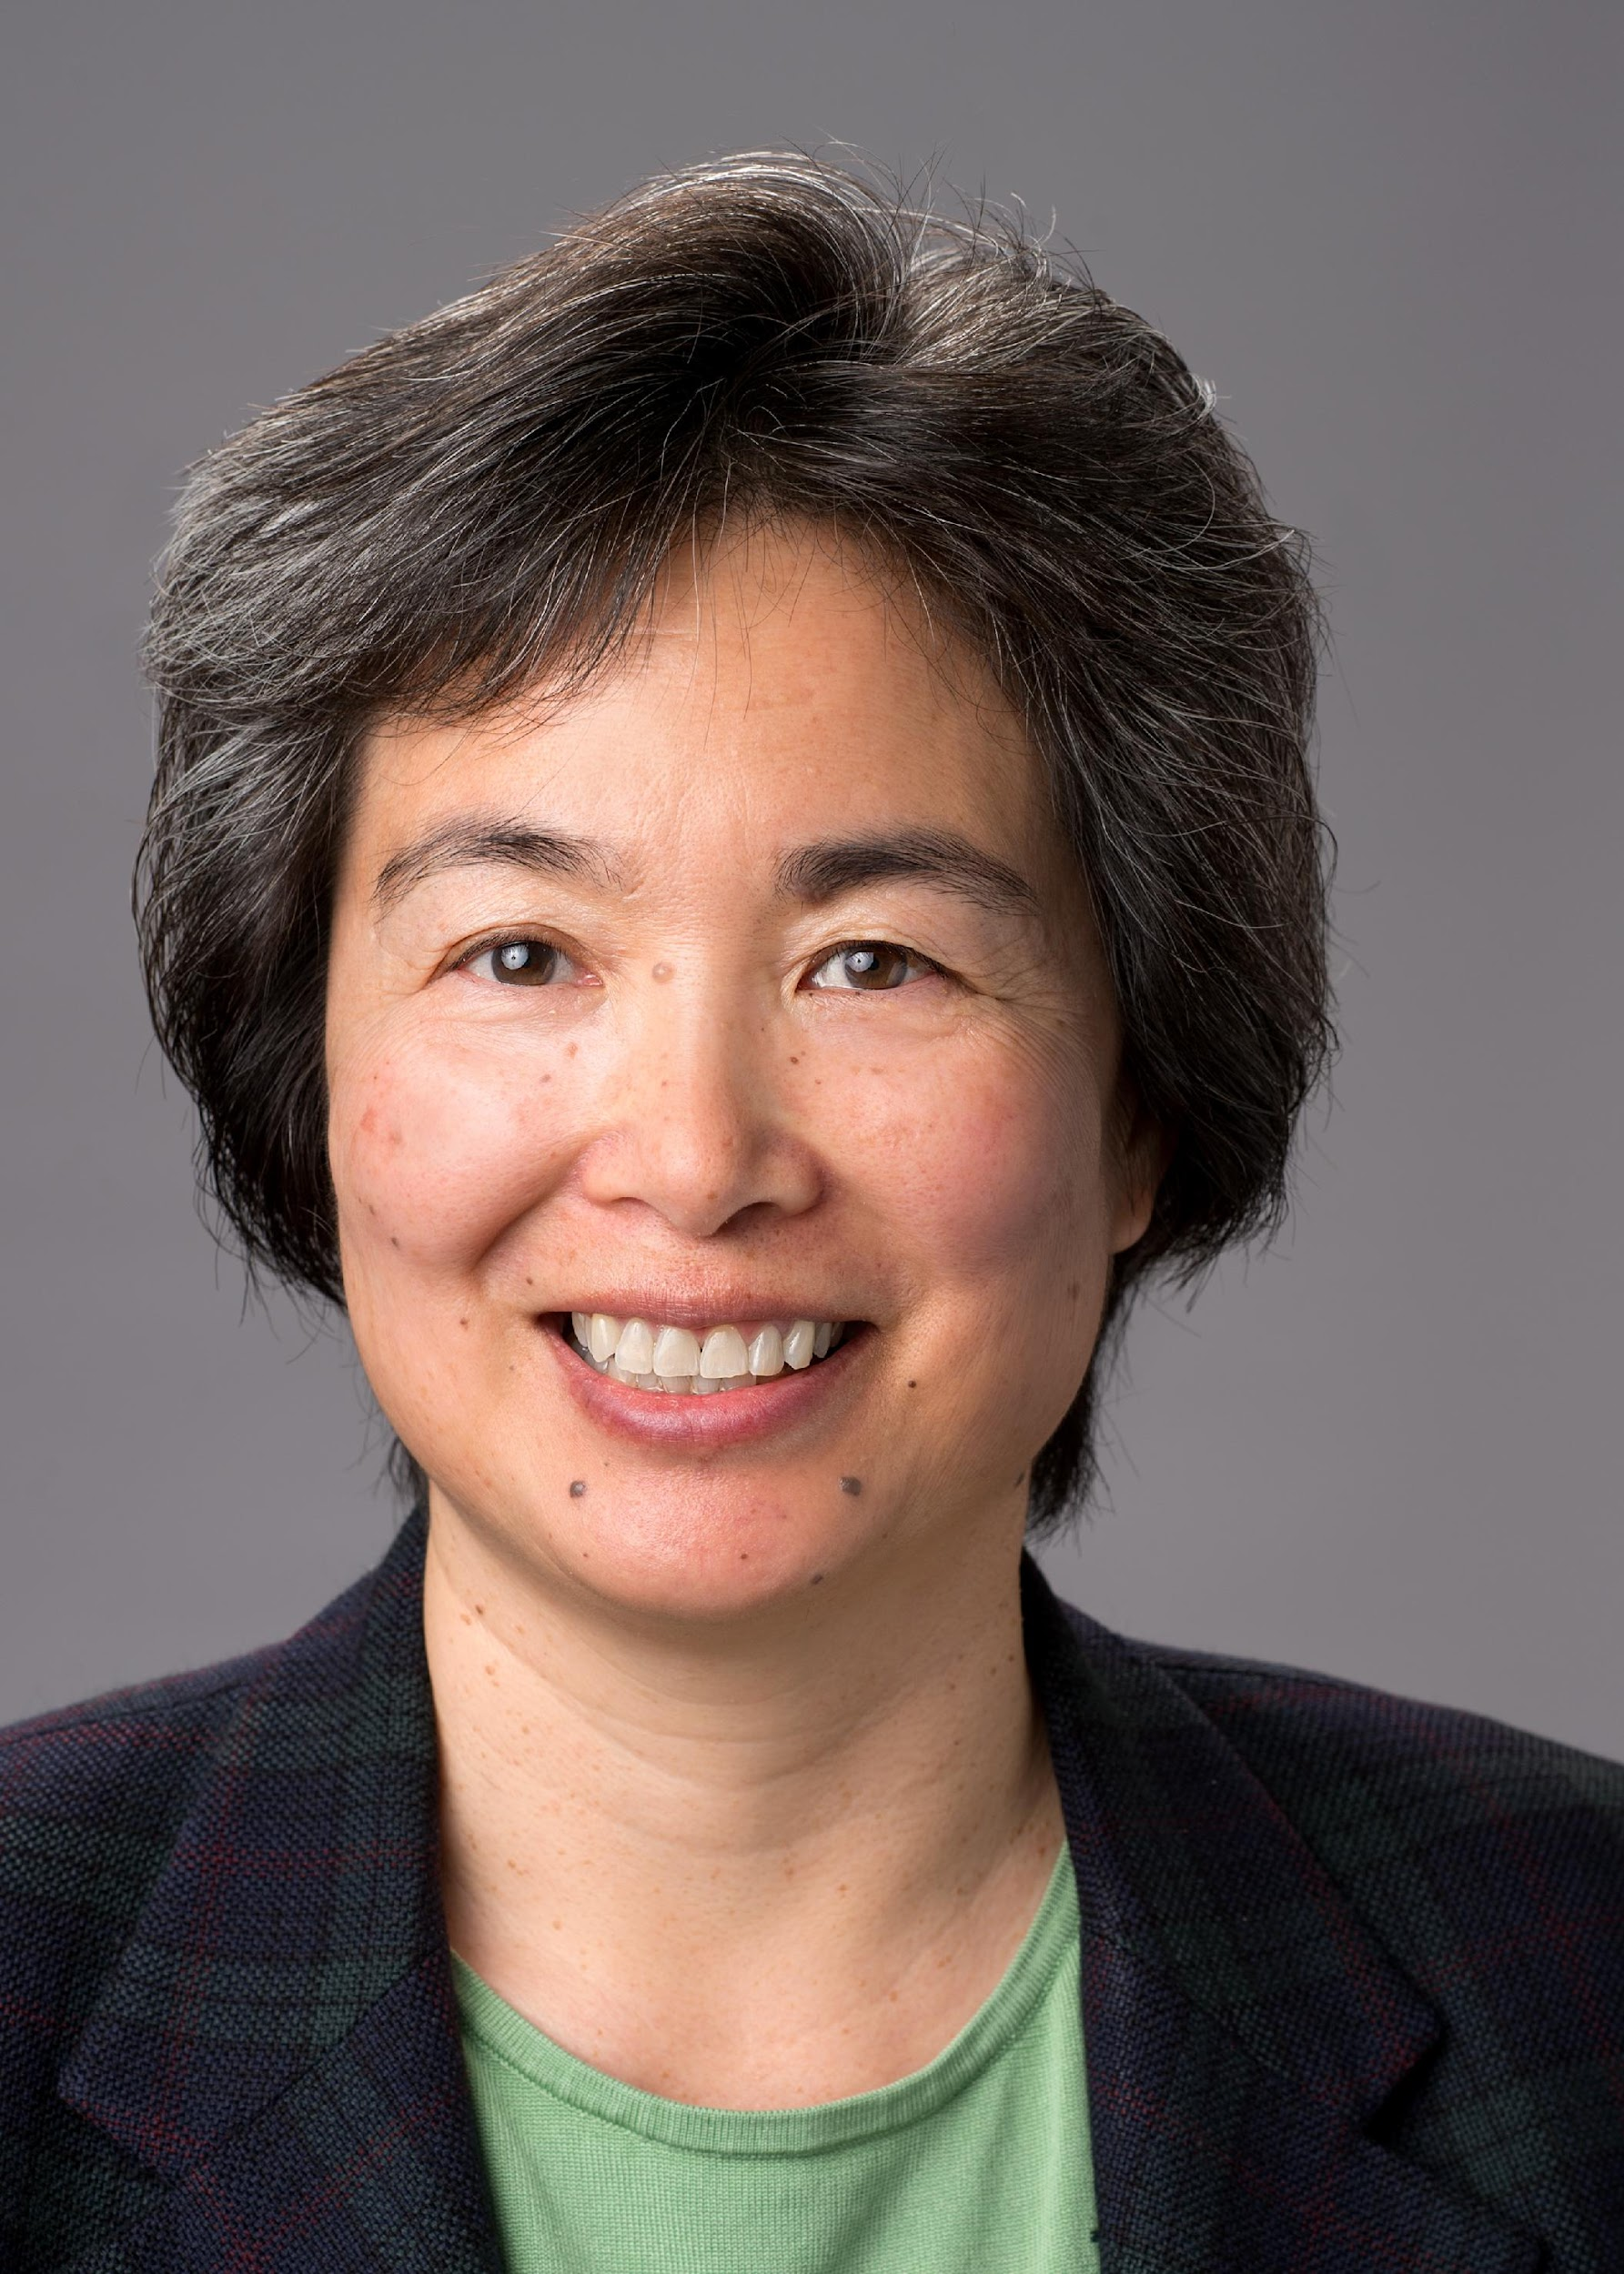
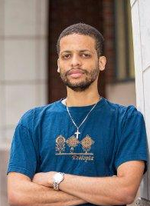
People
Aydin Buluç
Alvin Cheung
Jim Demmel
Jelani Nelson
Kathy Yelick
Krste Asanović
Bora Nikolić
Sophia Shao
Tsu-Jae King Liu
Programming Systems
Architecture and Hardware

Slide 16
Lab’s Lasagna Stack is (Too) Big
Applications
Machine Learning
Federated Learning
Interactive cloud
Data Analytics
Robotics,
AR/VR
Genomics
Wireless
Algorithms
Linear Algebra
Sketching
Compression
Randomized Algorithms
Ray Tracing
Dynamic Programming
Spectral Methods
Diff. privacy
RPC
SLAM/MPC
Libraries and Frameworks
BLAS
LAPACK
GraphBLAS
Protobuf
PyTorch
DGL
TensorFlow
UPC++
OSKI
BCL
RayLEAF
HipMCL
Ray
Serverless
DSLs, Compilers, Runtimes
Indigo
Dexter
Rake
Keystone
ONNX-RT-RISCV
ROS
Halide
Cross-Cutting Concerns
CPUs
Hwacha
Gemmini
Domain-Specific Accelerators
Architecture
Shared Memory
On-Chip Interconnect
On-Package Interconnect
Validation & Verification
Libraries
Berkeley Analog Generator
Security & Privacy
CAD Tools
FIRRTL
HAMMER
FPGA Prototype
FireSim
ASICs
Prototype
Systems
Hyperscale SIP
ARGO/RTML SoC
Robotics Chip
Notes:
Algorithms: MPC = model-predictive control in robotic algorithms (Sophia) SLAM = simultaneous localization and mapping (Bora) what’s VIO??
Library and Frameworks: HipMCL = a high-performance parallel implementation of the Markov clustering algorithm for large-scale networks (Aydin, Kathy) RayLEAF = federated learning on top of Ray (Jim) BCL = Berkeley container library (Kathy, Aydin) OSKI = low-level primitives for sparse matrix kernels (Jim) (white boxes = external tools) DGL = deep graph library that compiles to TF and Pytorch
DSLs and compilers and runtimes: Indigo = DSL for image processing (Kathy) Dexter = verified lifting based C to halide compiler (Alvin) Rake = instruction selection using program synthesis (Alvin) ONNX-RT-RISVC = runtime for execution of ONNX graphs (Sophia)

Slide 17
Do Fewer Things Well: Lasagna Slices
There are many domains, sharing common motifs
Can’t do all ⇒ Focus on 3-5
Real-Time Machine Learning
Data Analytics Cloud Acceleration
Robotics AR/VR
Genomics
?
Federated learning DNNs
TensorFlow/PyTorch
ONNX Runtime
Gemmini, Hwacha
FireSim evaluation Argo SoC generator
SiP baseline
GraphBLAS Compression Protocol Buffer
Protobuf accelerator
Hyperscale SoC prototype
SiP
ROS
SLAM, VIO
Raytracing
RISC-V DSP, Gemmini Hwacha
SoC
Assemble (HipMer)
Cluster (HipMCL)
Annotate (PersGNN)
Graphs
Sparse matrices
Hash tables
FireSim
.
.
.
Notes:
protobuf accelerator and compression acceleration

Slide 18
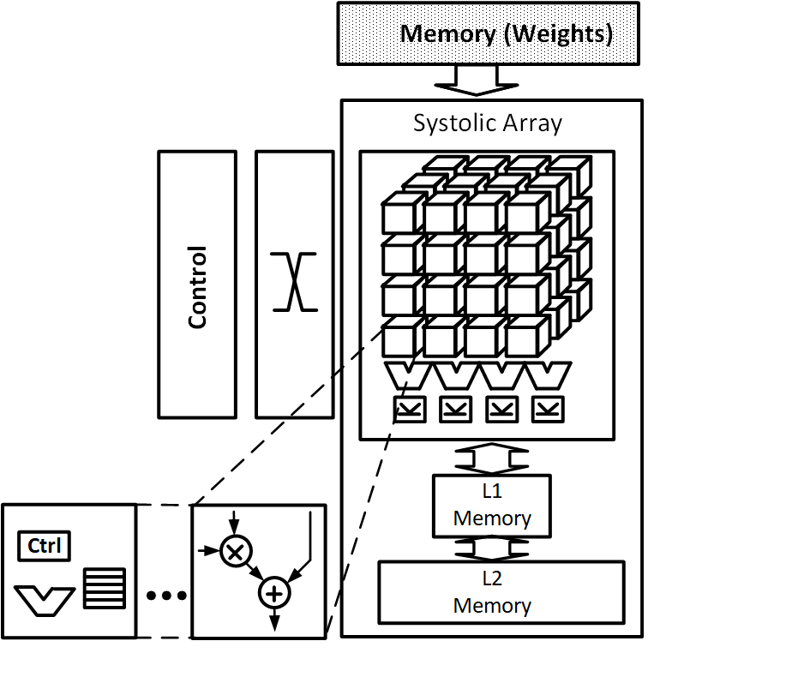
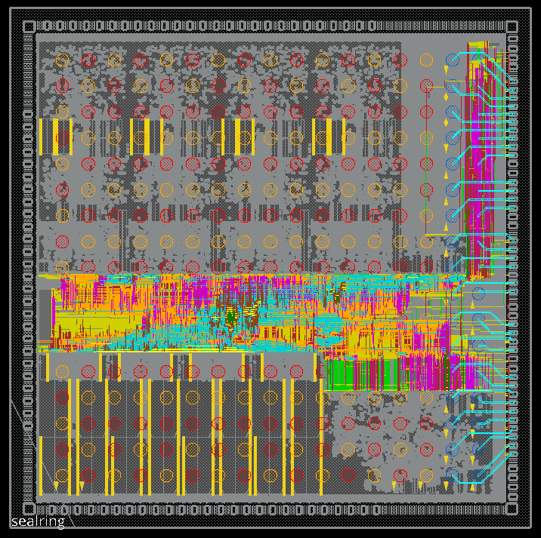
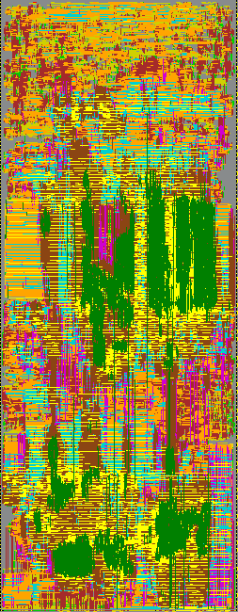
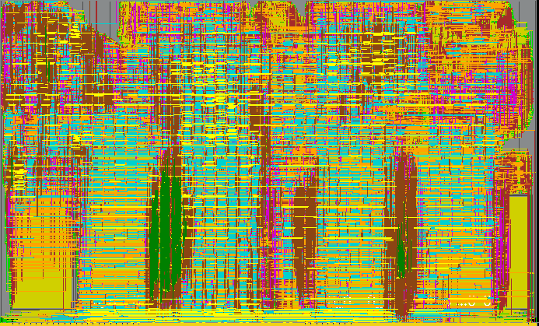
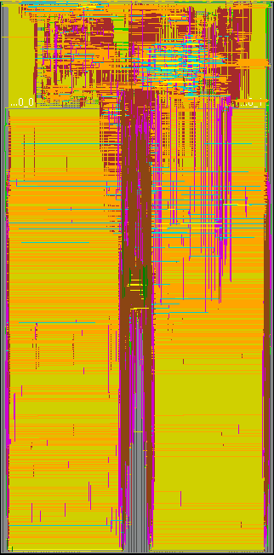
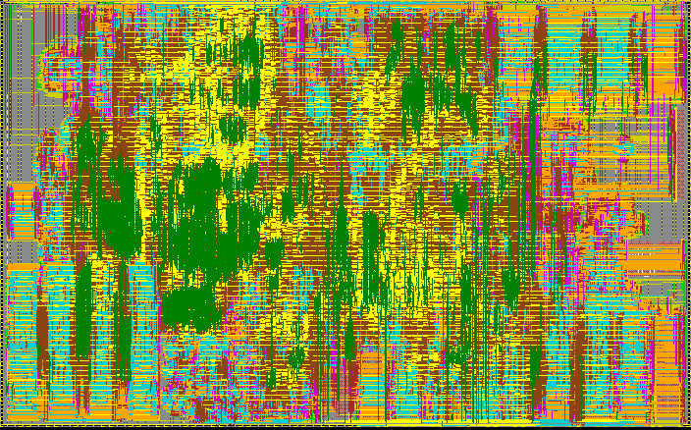
Example Lasagna Slices/Stovepipes
Example: Real-Time ML
Algorithms and Applications
Standard Benchmarks: MLPerf Training and Inference
Specific Design: Federated learning under privacy guarantees
Contributions from other research labs
(Predicting future…)
Accelerator and Software Generators
Automated Mapping
Automated Prototype SoC Build System
Hammer
System Performance Validation and Demonstration
ARGO
GF12
FPGAs in the cloud
Open-source tool flows

Slide 19
Building Domain-Specific Chiplets
Chiplet Interface
Application Tile
Application Tile
Application Tile
Memory IF Chiplet
SMU
NoC w/QoS
ML Tile
Chiplet Interface
ML Tile
DSP Tile
Chiplet Interface
NetworkingChiplet
Fixed- function Acc
DSP Tile
DSP Tile
Shared memory
Chiplet Interface

Slide 20
SLICE Lab Timeline
SLICE Launch (Jan 12, 2022)
ADEPT End of Project Party
Started ADEPT
Successor Meetings
SLICE 1st Retreat
SLICE End of Project Party!
2023
2027
2020
2021
2022
2024
2026
2025
We are here

Slide 21
SLICE Lab Engagement Model
SLICE will follows successful model from 40+ years
5-year mission
Supported by Government contracts and industry membership
Industry partners have early access to research results through retreats and direct engagement
Retreats are held twice a year, in May and January
Primary means for early dissemination of results
Can’t cover every topic every retreat in talks, but lots of posters
Lightning, 3-minute, previews
Visitors give feedback
Results are placed in open source under a permissive open-source license

Slide 22
ADEPT Celebration Party Logistics
Virtual talks during day
In-person reception at Memorial Stadium 4pm-7pm
Photos outside on Deck at Sunset 4:45pm

